Slide 1
Department of Oregon
Redistricting Proposal
Presented by the Reorganization Committee

Slide 2
Goals of the Redistricting Committee:
Establish a plan that allows for the next redistricting event to occur a minimum of three years in the future to minimize post-level disturbances.
Ensuring all districts have enough posts to engage in district-level activities, including conventions, and the support to grow posts across all geographic areas, while mitigating some post-to-post anticipated consolidations.
Facilitate in-person and distance meetings by minimizing distance and digital barriers for district-level activities.
Promote growth opportunities for officer leaders and committees to be able to grow new posts and revitalize struggling areas.
Maximizing district populations to consolidate experienced leadership and motivated members as cooperative teams.
Facilitating districts to have enough time to adjust to the new district structure and provide area-specific best practices for local implementation success.

Slide 3
National By-law Guidance:
National By-laws:
Article IV - Districts, Sec. 401 - Formation, Institution and Chartering.
The Department Convention or the Department Council of Administration, if provided for in Department Bylaws, shall determine the number of Districts and the geographical boundaries established in the Department. No District shall be established with less than five (5) Posts and 175 members.

Slide 4
National By-law Guidance:
National By-laws:
Article IV - Districts, Sec. 412 - Defunct Districts.
Notwithstanding the provisions of Section 410, if and when the Posts in good standing in a District are less than five (5) in number, the District’s charter may be canceled by the Department Convention. Disposition of Property. In all cases of surrender, revocation or forfeiture of a charter, title to all real and personal property shall immediately pass to the Department who shall take possession and control for disposition as directed by the Department Council of Administration for the purposes set forth in the Congressional Charter. In addition, the books and records of the District shall be recovered by the Department. In case of surrender or forfeiture of a charter, the Department Council of Administration in the case of trust funds or trust property, or both, shall carry out the intent and purpose of such trust to the extent of such funds or property, or both.

Slide 5
Department By-law Guidance:
ARTICLE IV ORGANIZATION
Section 1- The organization of this Department shall fully conform to Article V of the National Bylaws.
Section 2- The Department of Oregon shall be divided into Districts as may be determined by the Department Convention. Each District shall be presided over by a District Commander, who shall be elected as herein after setting forth and who shall after election and installation, be a member of the Department Council of Administration.
Section 3- In accordance with National Bylaws Section 403: The District shall hold at least (two) 2 regular meetings each year for purposes of transacting business and conducting schools of instruction. -Each District shall hold annual District Convention (District Spring Meeting) for the purpose of electing District Officers and for the transaction of business; such Convention to be held not less than ten (10) days nor more than seventy-five (75) days prior to the convening of the Department Convention.

Slide 6
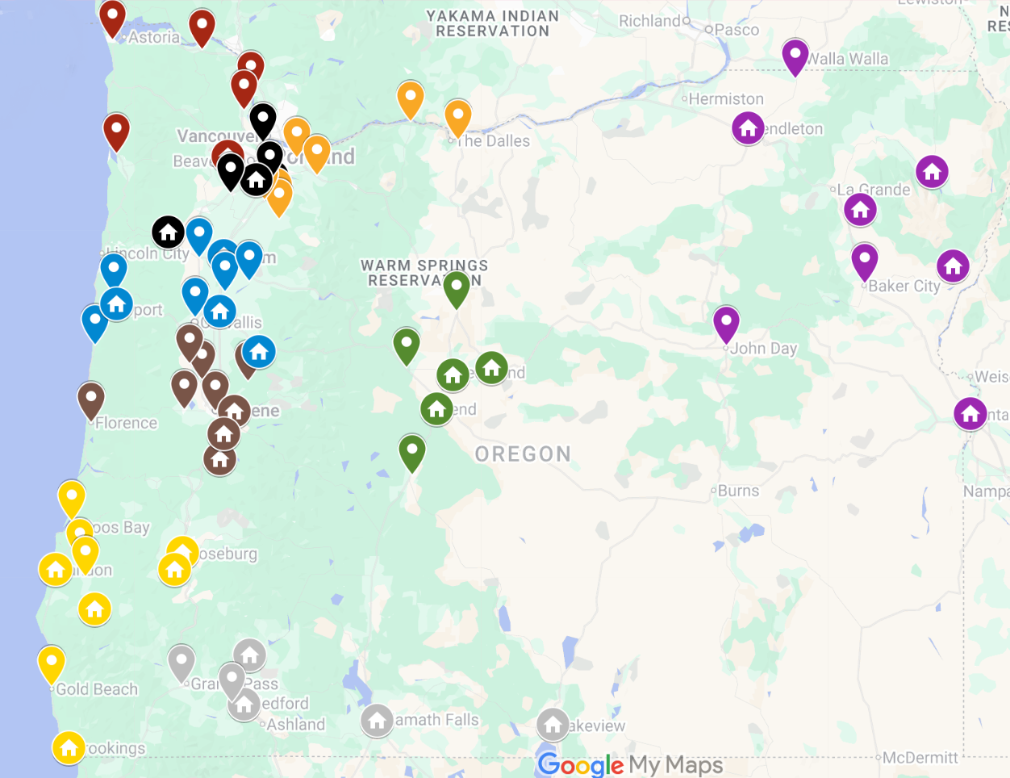

Proposed
Map:

Slide 7
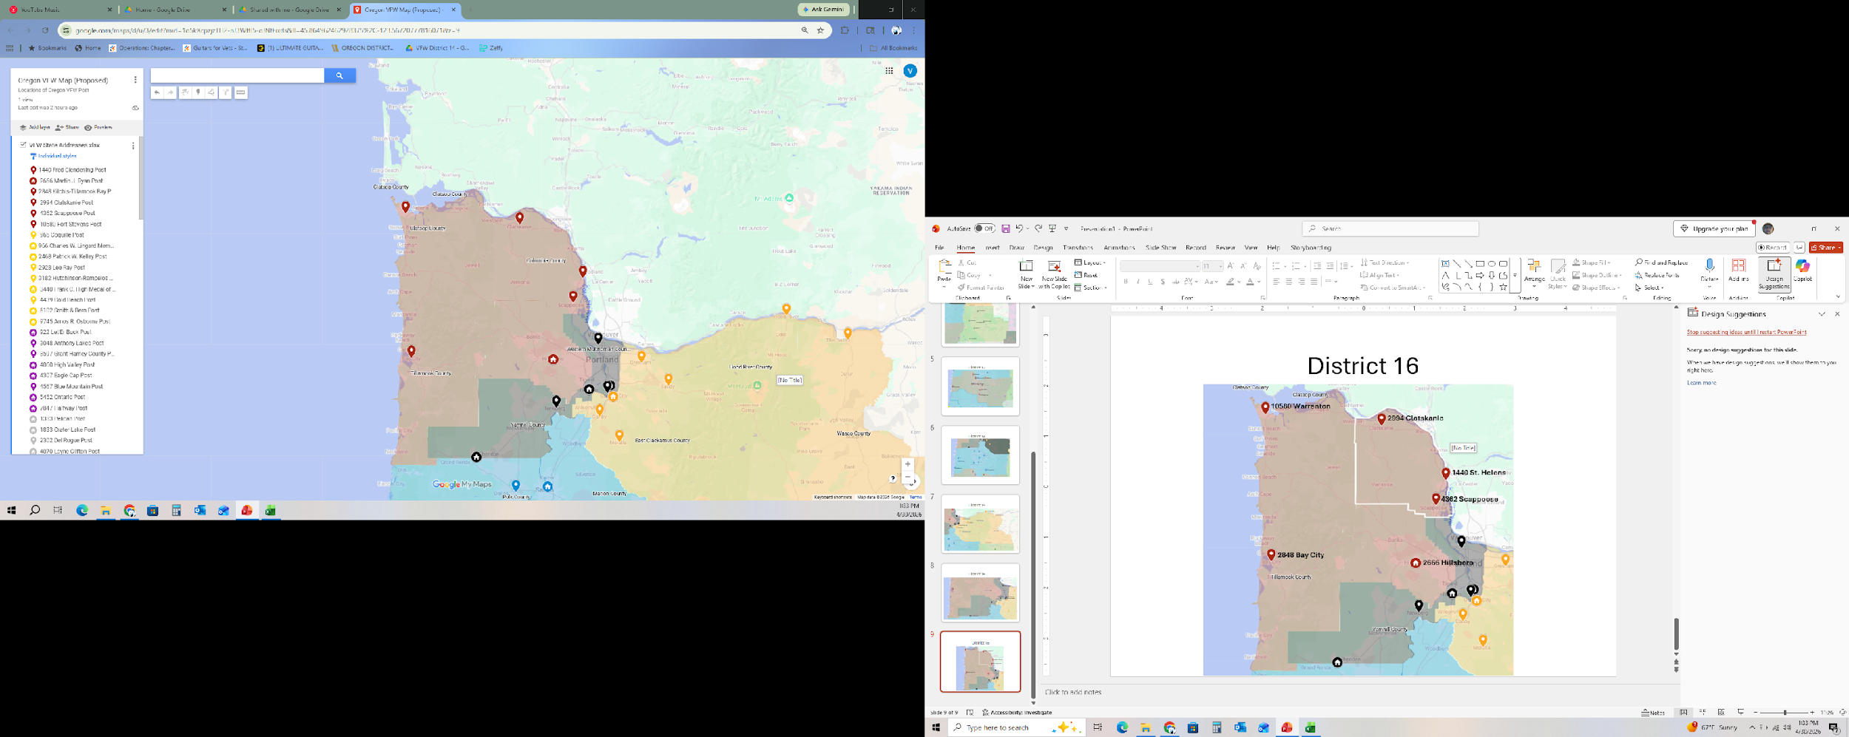
District 2
10580 Warrenton
2994 Clatskanie
1440 St. Helens
4362 Scappoose
2848 Bay City
2666 Hillsboro

Slide 8
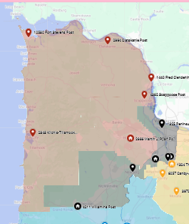
District 2:
Posts (1440, 2666, 2848, 2994, 4362, 10580)
Buildings Locations in District: Post 2666
Population & Age:
Total Life Members (LM) Population: 439
- Average Age LM: 71.4
Total Annual Members (AM) Population: 154
- Average Age AM: 66.1
Annual "Continuous" Members (ACM) Population: 98
- Average Age ACM: 66.9
Total Unpaid Members (UM) Population: 33
- Average Age UM: 66.4
Total New Members (NM) Population: 16
- Average Age NM: 57.3
Distance, farthest (Building to Post):
Hillsboro Building: 78.6 miles; 1 hour 38 min.

Slide 9
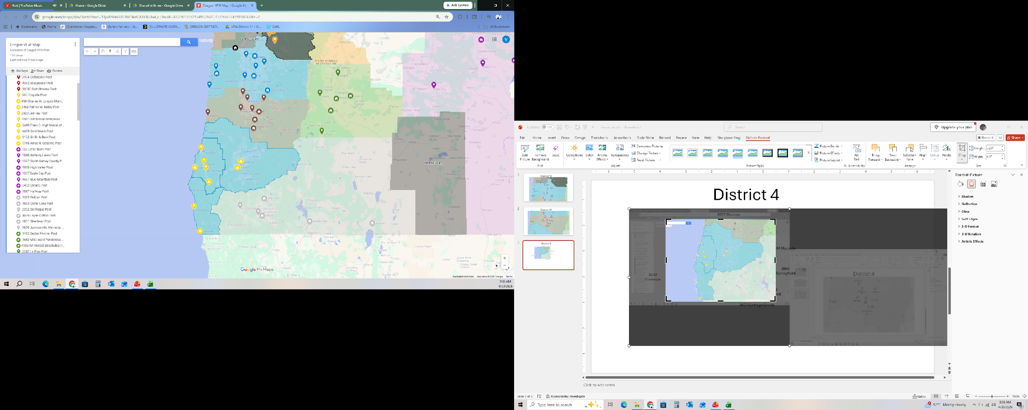
District 4
3182 North Bend
965 Coquille
2468 Roseburg
3440 Bandon
2928 Myrtle Point
9745 Winston
6102 Powers
4439 Gold Beach
966 Brookings

Slide 10
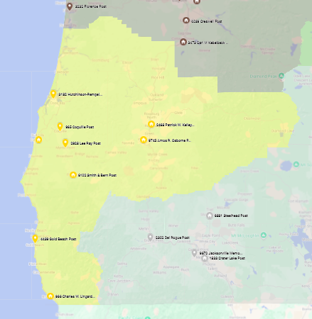
District 4:
Posts (965, 966, 2468, 2928, 3182, 3440, 4439, 6102, 9745)
Buildings Locations in District: Post 4211
Population & Age:
Total Life Members (LM) Population: 688 - Average Age LM: 76.1
Total Annual Members (AM) Population: 90 - Average Age AM: 69.6
Annual "Continuous" Members (ACM) Population: 38 - Average Age ACM: 67.7
Total Unpaid Members (UM) Population: 40 - Average Age UM: 65.9
Total New Members (NM) Population: 8 - Average Age NM: 65.4
Distance, farthest (Building to Post):
Roseburg Building: 166 miles, 3 hour 11 min.
Bandon Building: 84.5 miles, 1 hour 40 min.
Winston Building :153 miles, 3 hour 4 min.
Powers Building: 93.4 miles, 2 hour 32 min.
Brookings Building: 166 miles, 3 hour 11 min.

Slide 11
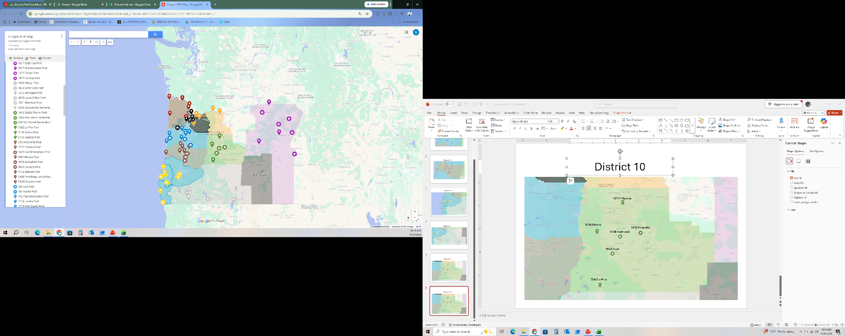
District 6
4567 Milton Free Water
922 Pendleton
4307 Enterprise
4060 Union
3048 Baker City
7847 Halfway
3597 John Day
5452 Ontario

Slide 12
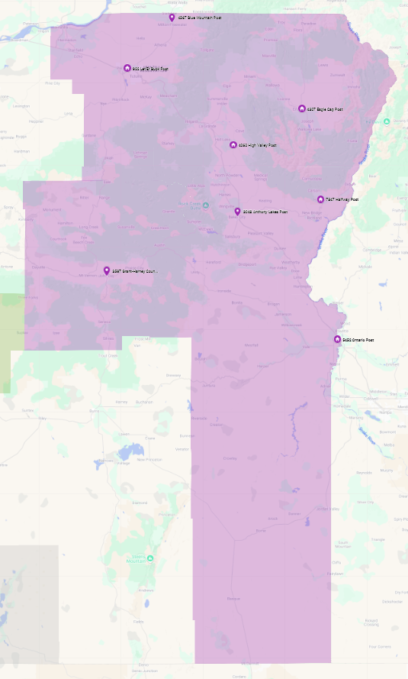
District 6 :
Posts (922, 3048, 3597, 4060, 4307, 4567, 5452, 7847)
Buildings in District: 5452, 7847, 4060, 4307, 922
Population & Age:
Total Life Members (LM) Population: 619
- Average Age LM: 71.5
Total Annual Members (AM) Population: 101
- Average Age AM: 67.4
Annual "Continuous" Members (ACM) Population: 45
- Average Age ACM: 70.7
Total Unpaid Members (UM) Population: 43
- Average Age UM: 62.7
Total New Members (NM) Population: 7
- Average Age NM: 58.3
Distance, farthest (Building to Post):
Pendleton Building: 167 miles, 2 hrs. 37 min.
Enterprise Building: 185 miles, 3 hrs. 31 min.
Halfway Building: 167 miles, 2 hrs. 56 min.
Ontario Building: 190 miles, 3 hrs. 3 min.
Union Building: 108 miles, 1 hr. 47 min.

Slide 13
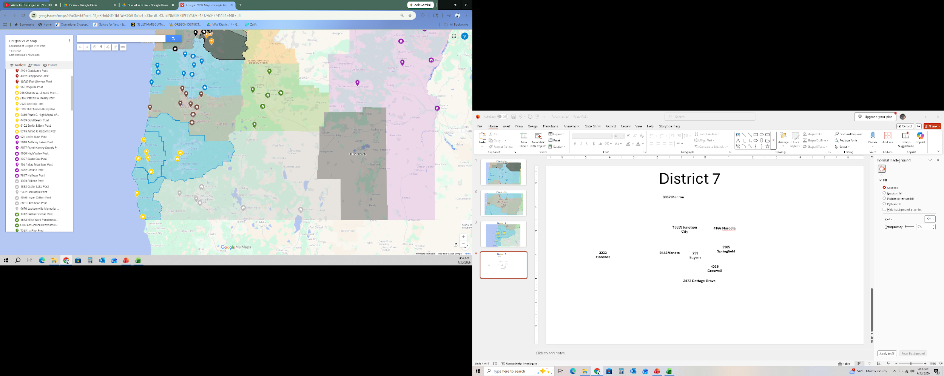
District 7
6881 Shady Cove
2302 Grants Pass
9670 Jacksonville
1833 Medford
1383 Klamath Falls
4070 Lakeview

Slide 14
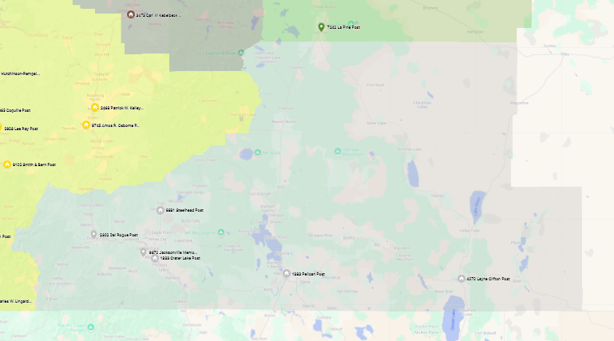
District 7 :
Posts (1383, 1833, 2302, 4070, 6881, 9670)
Buildings in District: 1383, 1833, 4070, 6881
Population & Age:
Total Life Members (LM) Population: 917
- Average Age LM: 74.6
Total Annual Members (AM) Population: 155 - Average Age AM: 63.9
Annual "Continuous" Members (ACM) Population: 54 - Average Age ACM: 66.7
Total Unpaid Members (UM) Population: 56 - Average Age UM: 66.5
Total New Members (NM) Population: 8
- Average Age NM: 63.8
Distance, farthest (Building to Post):
Shady Cove Building : 173 miles, 3 hour 5 min.
Crater Lake: 173 miles, 3 hour 5 min.
Klamath Falls: 95.1 miles, 1 hour 47 min.
Lakeview: 173 miles, 3 hour 5 min.

Slide 15
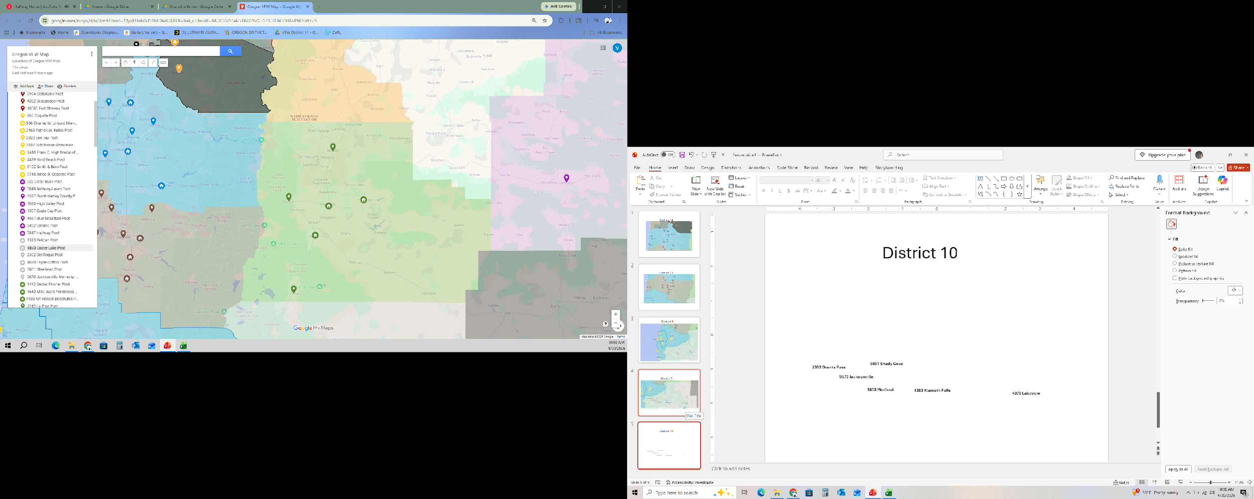
District 10
12141 Madras
8138 Sisters
1412 Prineville
4108 Redmond
1643 Bend
7242 La Pine

Slide 16
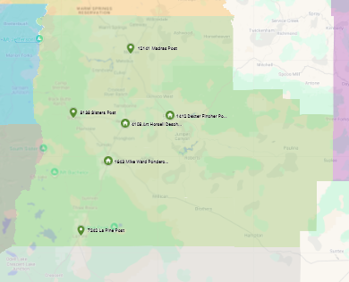
District 10:
Posts (1412, 1643, 4108, 7242, 8138, 12141)
Buildings in District: 1643, 4108, 1412
Population & Age:
Total Life Members (LM) Population: 903
- Average Age LM: 71.7
Total Annual Members (AM) Population: 181
- Average Age AM: 64.3
Annual "Continuous" Members (ACM) Population: 84
- Average Age ACM: 72.8
Total Unpaid Members (UM) Population: 71
- Average Age UM: 57.7
Total New Members (NM) Population: 11
- Average Age NM: 45.0
Distance, farthest (Building to Post):
Prineville Building: 41.7 miles, 52 min.
Redmond Building: 45.9 miles, 50 min.
Bend Building: 64.5 miles, 1 hour 14 min.

Slide 17
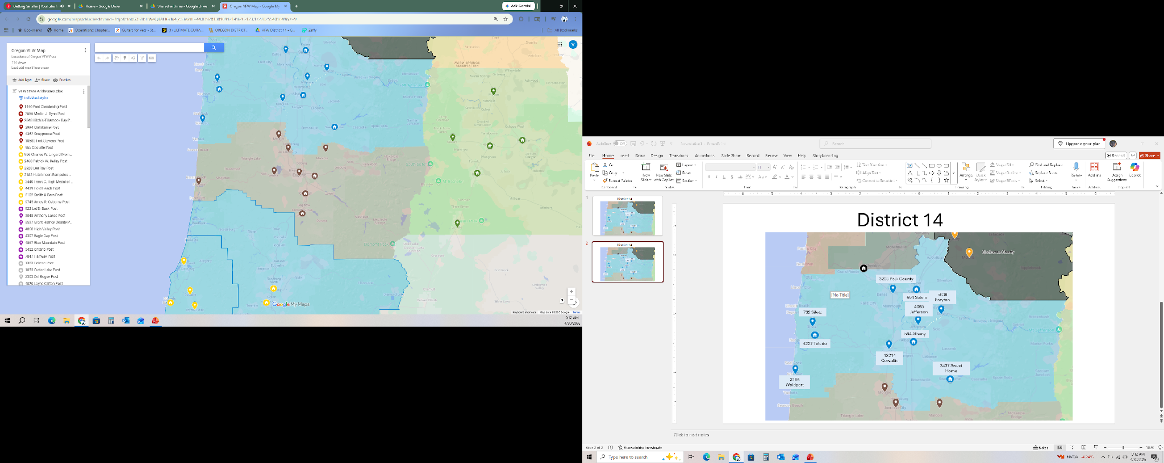
District 13
3957 Monroe
10639 Junction City
4166 Marcola
9448 Veneta
293 Eugene
3232 Florence
3965 Springfield
4039 Creswell
3473 Cottage Grove

Slide 18
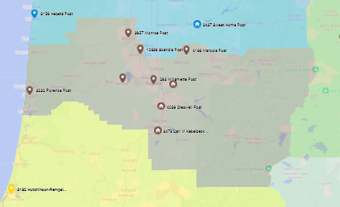
District 13:
Posts (293, 3232, 3473, 3957, 3965, 4039, 4166, 9448, 10639)
Buildings in District: 3473, 3965, 4039
Population & Age:
Total Life Members (LM) Population: 1122
- Average Age LM: 72.8
Total Annual Members (AM) Population: 274
- Average Age AM: 67.4
Annual "Continuous" Members (ACM) Population: 114
- Average Age ACM: 76.2
Total Unpaid Members (UM) Population: 141
- Average Age UM: 58.0
Total New Members (NM) Population: 11
- Average Age NM: 69.7
Distance, farthest (Building to Post):
Springfield Building: 85.5 miles, 1 hour 43 min.
Creswell Building: 79.7 miles, 1 hour 40 min.
Cottage Grove Building: 74.0 miles, 1 hour 28 min.

Slide 19
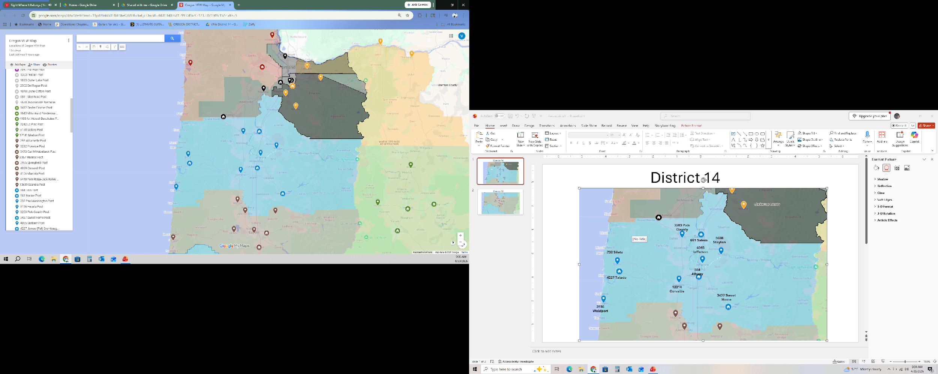
District 14
3203 Polk County
661 Salem
5638 Stayton
732 Siletz
4065 Jefferson
4227 Toledo
12214 Corvallis
584 Albany
3156 Waldport
3437 Sweet Home

Slide 20
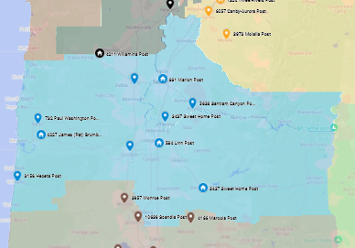
District 14:
Posts (584, 661, 732, 3156, 3203, 3437, 4065, 4227, 5638, 12214)
Buildings in District: 584, 661, 3437, 4227
Population & Age:
Total Life Members (LM) Population: 1039
- Average Age LM: 69.8
Total Annual Members (AM) Population: 237
- Average Age AM: 62.7
Annual "Continuous" Members (ACM) Population: 87
- Average Age ACM: 66.6
Total Unpaid Members (UM) Population: 120
- Average Age UM: 58.6
Total New Members (NM) Population: 10
- Average Age NM: 50.8
Distance, farthest (Building to Post):
Albany Building: 80.2 miles, 1 hour 41 min.
Salem Building: 97.8 miles, 2 hours 1 min.
Sweet Home Building: 96.2 miles, 2 hours 4 min.
Toledo Building: 75.2 miles, 1 hour 31 min.

Slide 21
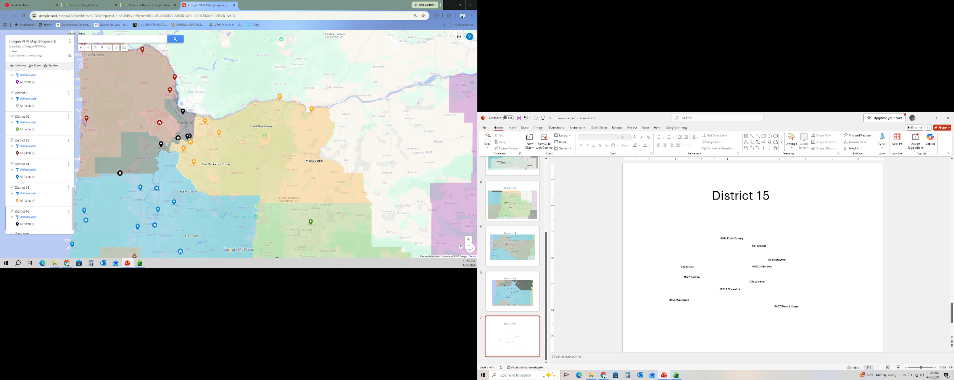
District 15
12211 Hood River
2471 The Dalles
180 Gresham
4273 Sandy
1324 Oregon City
6057 Canby
6057 Molalla

Slide 22
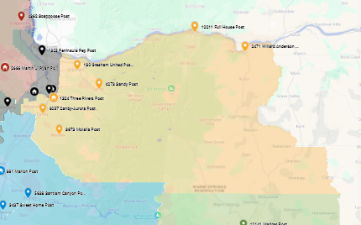
District 15:
Posts (180, 1324, 2471, 3973, 4273, 6057, 12211)
Buildings in District: 1324
Population & Age:
Total Life Members (LM) Population: 1005
- Average Age LM: 68.0
Total Annual Members (AM) Population: 471
- Average Age AM: 61.6
Annual "Continuous" Members (ACM) Population: 103
- Average Age ACM: 71.6
Total Unpaid Members (UM) Population: 337 -
Average Age UM: 58.2
Total New Members (NM) Population: 12
- Average Age NM: 57.8
Distance, farthest (Building to Post): 94.4 miles,
1 hour 40 min.

Slide 23
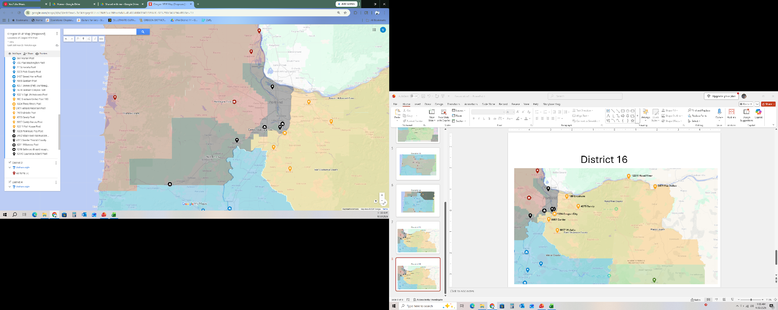
District 16
1325 N. Portland
3452 Tualatin
4248 S. Portland
12140 Lake Oswego
4015 Newberg
4211 Willamina

Slide 24
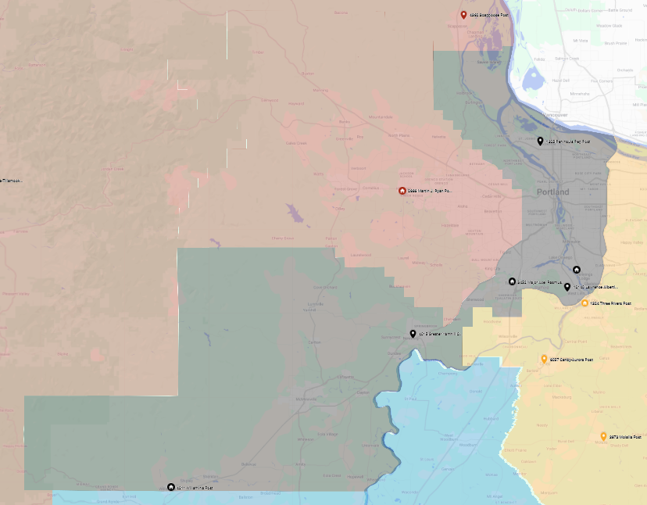
District 16:
Posts (1325, 3452, 4015, 4211, 4248, 12140)
Buildings in District: 3452, 4211
Population & Age:
Total Life Members (LM) Population: 970
- Average Age LM: 71.9
Total Annual Members (AM) Population: 113
- Average Age AM: 63.1
Annual "Continuous" Members (ACM) Population: 36 - Average Age ACM: 66.6
Total Unpaid Members (UM) Population: 60
- Average Age UM: 55.5
Total New Members (NM) Population: 7
- Average Age NM: 43.3
Distance, farthest (Building to Post):
Building in Tualatin: 44.7 miles: 1 hour 5 min.,
Building in Willamina: 62.6 miles, 1 hour 46 min.

Slide 25
P
O
P
U
L
A
T
I
O
N
All Districts | % Change | Current # | Proposed # | Overall %
Total Population | 0% | 11428 | 11428 | 100.00%
District 2 | 54% | 385 | 593 | 5.19%
District 3 | 194% | 365 | 1072 | 9.38%
District 4 | 90% | 410 | 778 | 6.81%
District 5 | -100% | 622 | 0 | 0.00%
District 6 | 54% | 467 | 720 | 6.30%
District 7 | 138% | 450 | 1072 | 9.38%
District 8 | -100% | 296 | 0 | 0.00%
District 10 | 0% | 1084 | 1084 | 9.49%
District 13 | -19% | 1727 | 1396 | 12.22%
District 14 | -3% | 1313 | 1276 | 11.17%
District 15 | -6% | 1564 | 1476 | 12.92%
District 16 | 36% | 795 | 1083 | 9.48%

